Slide 1
What is Internet?
Notes:
I always find it difficult to define such generic terms.

Slide 2
Internet
Network of computer systems which communicate with each other to exchange information through standard set of protocols.
One such protocol is HTTP
Notes:
Why standard? Standard because then all systems can understand what needs to be implemented.

Slide 3
HTTP(Hypertext Transfer Protocol)
Hypertext: Text served on the internet containing hyperlinks to other resources
Multimedia: Hypertext and graphics, audio and video
Notes:
But http is not just used to transfer text now. It is used to serve multimedia

Slide 4
ech tee tee pee
Hypertext Transfer Protocol
Application layer ( layer wa ??? )
stateless ( New Zealand )
connectionless or connection oriented
Notes:
Hypertext Transfer Protocol
osi layers
statefull connections
Connection oriented(order does not matter)
What does HTTP use TCP UDP

Slide 5
HTTP Methods
GET
Requests a representation of the specified resource. Requests using GET should only retrieve data and should have no other effect. But nobody adheres to this on the web ...
POST
Requests that the server accept the entity enclosed in the request as a new subordinate of the web resource identified by the URI.
curl http://httpbin.org/get -v
curl --data "param1=value1&param2=value2" "http://httpbin.org/post" -v

Slide 6
HTTP (text protocol)
tsunami-box$ telnet localhost 80
GET /index.php HTTP/1.1
User-Agent: user-agent
Host: localhost:80
Accept: */*
HTTP/1.1 200 OK
Date: Fri, 04 Jul 2014 11:04:20 GMT
Server: Apache/2.2.22 (Ubuntu)
Last-Modified: Fri, 26 Apr 2013 11:52:07 GMT
ETag: "1e20b4-b1-4db422a19aa97"
Accept-Ranges: bytes
Content-Length: 177
Vary: Accept-Encoding
Content-Type: text/html
X-Pad: avoid browser bug
<html><body><h1>It works!</h1>
<p>This is the default web page for this server.</p>
<p>The web server software is running but no content has been added, yet.</p>
</body></html>
Notes:
mash-$ telnet localhost 80
GET /index.html HTTP/1.1
User-Agent: curl/7.29.0
Host: localhost:89
Accept: */*
curl "http://localhost:89/index.html" --trace -

Slide 7
HTTP METHODS
THATS IT RIGHT ???
YA RIGHT !!!

Slide 8
HEAD
Asks for the response identical to the one that would correspond to a GET request, but without the response body. This is useful for retrieving meta-information written in response headers, without having to transport the entire content.
PUT
Requests that the enclosed entity be stored under the supplied URI. If the URI refers to an already existing resource, it is modified; if the URI does not point to an existing resource, then the server can create the resource with that URI. [Idempotent]
curl http://httpbin.org/get -v -I
curl -X PUT -d arg=val -d arg2=val2 "http://httpbin.org/put" -v

Slide 9
HTTP METHODS
DELETE
Deletes the specified resource. [Idempotent]
TRACE
Echoes back the received request so that a client can see what (if any) changes or additions have been made by intermediate servers.
OPTIONS
Returns the HTTP methods that the server supports for the specified URL. This can be used to check the functionality of a web server by requesting '*' instead of a specific resource.
CONNECT
Converts the request connection to a transparent TCP/IP tunnel, usually to facilitate SSL-encrypted communication (HTTPS) through an unencrypted HTTP proxy.
PATCH
Is used to apply partial modifications to a resource.

Slide 10
HTTP Status Codes
Successful – 2xx
Redirection – 3xx
Client Error – 4xx
Server Error – 5xx
http://www.restapitutorial.com/httpstatuscodes.html

Slide 11
Headers
Operating parameters of transaction
Common Request Headers
Host
Content-Type
Content-Length
User-Agent
Common Response Headers
Date
Content-Type
Set-Cookie
Content-Encoding
curl -H "Accept-Encoding: gzip,deflate" "http://www.theverge.com/" -I -vN

Slide 12
Caching Headers
http://www.mobify.com/blog/beginners-guide-to-http-cache-headers/

Slide 13
Caching Headers
Reduces network traffic
Reduces load time
Cache expiry headers
Expires
Cache-Control: max-age (overrides Expires)
There are only two hard things in Computer Science: cache invalidation and naming things. (Phil Karlton)
Resource version in URL

Slide 14
Conditional Headers
Last-Modified
ETag
Conditional GET
If-Modified-Since
If-None-Match
If-Range
Notes:
If-modified-since[date] if not modified 304 response code
If-none-match ??
If-range[date/ entity] send 206 response with partial response if matched

Slide 15
Cookies
Small pieces of data stored on client and sent on every request
Use Cases:
Session management
Personalization
Tracking

Slide 16
Cookies
Can be set both through headers and with JS
Cookie attributes
Path
Expires
Secure
Domain
HttpOnly
Set-Cookie Header
MyCookie=ChocoChip; Expires=Wed, 09 Jun 2021 10:18:14 GMT

Slide 17
Authentication
HTTPS - TLS Handshake
Content Negotiation
Accept, Accept-Language
Proxies
Forward & Reverse Proxies
Optimizations???
CDN …

Slide 18
Web API
Allows access to data without scrapping
HTTP + Definition of response format
Allows multiple interfaces to your application
SOA
SOAP and REST

Slide 19
SOAP
Simple Object Access Protocol
yeah very SIMPLE
Defines an entire protocol on top of other application protocols
Supports only XML
Reads cannot be cached
Requires special tools to create a client
Generally worse performance

Slide 20
REST
Representational state transfer. Defined by Roy Fielding in 2000. He was also a principal author of HTTP 1.0 & 1.1
Wiki says :
REST is an architectural style consisting of a coordinated set of architectural constraints applied to components, connectors, and data elements, within a distributed hypermedia system. REST ignores the details of component implementation and protocol syntax in order to focus on the roles of components, the constraints upon their interaction with other components, and their interpretation of significant data elements

Slide 21
REST
http://www.ics.uci.edu/~fielding/pubs/dissertation/rest_arch_style.htm
6 Constraints
Client-Server (Separation of concerns)
Stateless (state should be addressable by URL)
Cacheable
Layered system
Code on Demand (Optional)
Uniform Interface

Slide 22
Checkout:
https://speakerdeck.com/cprerovsky/rest-in-peace-number-devoxxpl-2016-talk
https://dev.twitter.com/rest/reference

Slide 23
tips
Endpoint Naming - Use plurals GET /nodes
HTTP verbs - CRUD : POST-GET-PUT-DELETE
Subresources
Data formats : Decide for one output format
Models and Resources
Status codes
Path Parameters and resources
API versioning
State
Id’s
REST clients

Slide 24
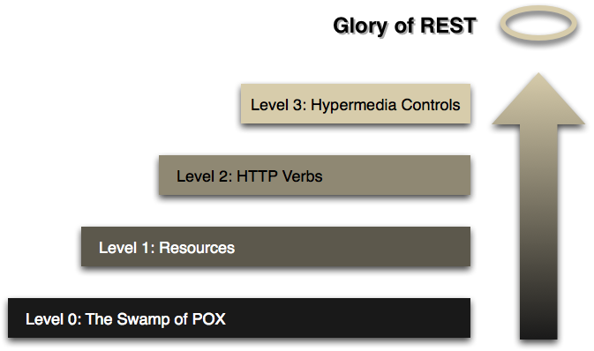
RMM
http://www.infoq.com/news/2010/03/RESTLevels

Slide 25
More on Level 3
HATEOAS : https://en.wikipedia.org/wiki/HATEOAS
Self Study : http://www.slideshare.net/josdirksen/rest-from-get-to-hateoas

Slide 26
REST spec sheet design
BUILD A TODO APP
Notes:
CRUD todo
CRUD user

Slide 27
NOW YOU GUYS CAN REST !!!

